Slide 1
Web Technologies
Kamran
Lecture 5

Slide 2

Contents
Div and Span
HTML Tables
HTML Form

Slide 3
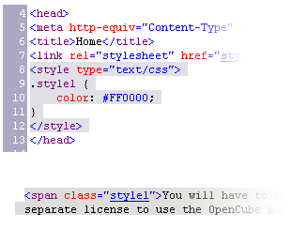

Using <DIV> and <SPAN> Block and Inline Elements

Slide 4
Block and Inline Elements
Block elements add a line break before and after them
<div> is a block element
Other block elements are <table>, <hr>, headings, lists, <p> and etc.
Inline elements don’t break the text before and after them
<span> is an inline element
Most HTML elements are inline, e.g. <a>

Slide 5
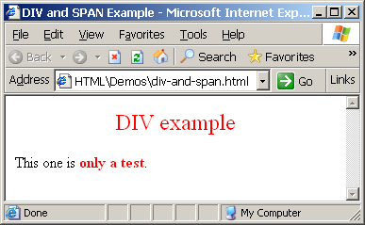
The <div> Tag
<div> creates logical divisions within a page
Block style element
Used with CSS
Example:
div-and-span.html
<div style="font-size:24px; color:red">DIV example</div>
<p>This one is <span style="color:red; font-weight:bold">only a test</span>.</p>

Slide 6


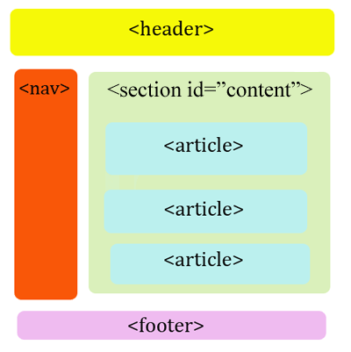
<DIV>
Live Demo
<DIV>

Slide 7
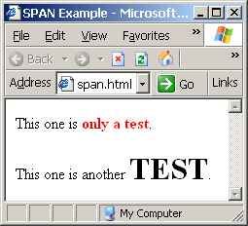
The <span> Tag
Inline style element
Useful for modifying a specific portion of text
Don't create a separate area (paragraph) in the document
Very useful with CSS
span.html
<p>This one is <span style="color:red; font-weight:bold">only a test</span>.</p>
<p>This one is another <span style="font-size:32px; font-weight:bold">TEST</span>.</p>

Slide 8


<SPAN>
Live Demo
<SPAN>some text</span>

Slide 9
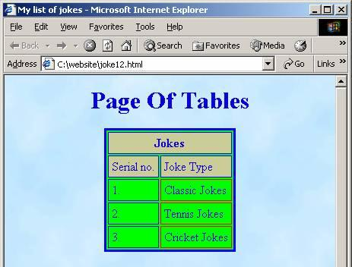
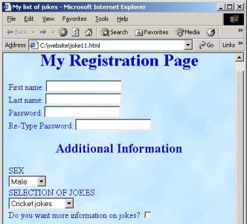

HTML – Tables and Forms
Muhammad Kamran

Slide 10
HTML Tables
Tables represent tabular data
A table consists of one or several rows
Each row has one or more columns
Tables comprised of several core tags: <table></table>: begin / end the table <tr></tr>: create a table row <td></td>: create tabular data (cell)
Tables are losing favor to <div> and <span>, with the CSS revolution

Slide 11
HTML Tables (2)
Start and end of a table
Start and end of a row
Start and end of a cell in a row
<table> ... </table>
<tr> ... </tr>
<td> ... </td>

Slide 12
Simple HTML Tables – Example
<table border="1" cellspacing="0" cellpadding="5">
<tr>
<td><img src="ppt.gif"></td>
<td><a href="lecture1.ppt">Lecture 1</a></td>
</tr>
<tr>
<td><img src="ppt.gif"></td>
<td><a href="lecture2.ppt">Lecture 2</a></td>
</tr>
<tr>
<td><img src="zip.gif"></td>
<td><a href="lecture2-demos.zip">
Lecture 2 - Demos</a></td>
</tr>
</table>

Slide 13
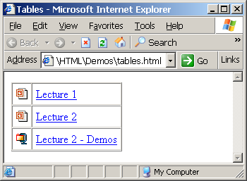
Simple HTML Tables – Example (2)
<table border="1" cellspacing="0" cellpadding="5">
<tr>
<td><img src="ppt.gif"></td>
<td><a href="lecture1.ppt">Lecture 1</a></td>
</tr>
<tr>
<td><img src="ppt.gif"></td>
<td><a href="lecture2.ppt">Lecture 2</a></td>
</tr>
<tr>
<td><img src="zip.gif"></td>
<td><a href="lecture2-demos.zip">
Lecture 2 - Demos</a></td>
</tr>
</table>

Slide 14

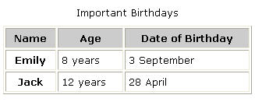

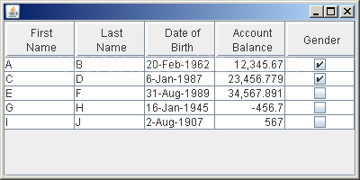
Simple HTML Tables
Live Demo

Slide 15
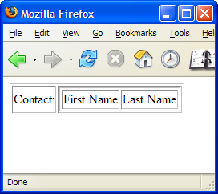
Nested Tables
Table data “cells” (<td>) can contain nested tables (tables within tables):
nested-tables.html
<table border="1">
<tr>
<td>Contact:</td>
<td>
<table border="1">
<tr>
<td>First Name</td>
<td>Last Name</td>
</tr>
</table>
</td>
</tr>
</table>

Slide 16
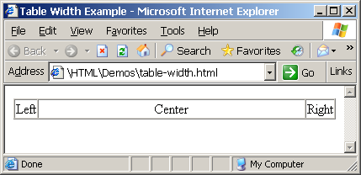
Cells Width
Tables and cells can have width attribute
Width can be given in pixels or percentages
table-width.html
<table border="1" width="100%" cellspacing="0">
<tr>
<td>Left</td>
<td width="100%" align="center">Center</td>
<td>Right</td>
</tr>
</table>

Slide 17
Cell Spacing and Padding
Tables have two important attributes:
cellspacing
Defines the empty space between the cells
cellpadding
Defines the empty space around the cell contents
cell
cell
cell
cell
cell
cell
cell
cell

Slide 18
Cell Spacing and Padding – Example
table-cells.html
<html>
<head><title>Table Cells</title></head>
<body>
<table cellspacing="15" cellpadding="0"
bgcolor="red">
<tr><td bgcolor="yellow">First</td>
<td bgcolor="yellow">Second</td></tr>
</table>
<br/>
<table cellspacing="0" cellpadding="10"
bgcolor="yellow" border="1">
<tr><td>First</td><td>Second</td></tr>
</table>
</body>
</html>

Slide 19
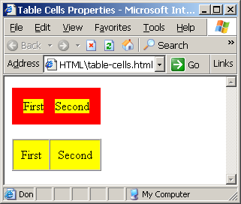
Cell Spacing and Padding – Example (2)
table-cells.html
<html>
<head><title>Table Cells</title></head>
<body>
<table cellspacing="15" cellpadding="0"
bgcolor="red">
<tr><td bgcolor="yellow">First</td>
<td bgcolor="yellow">Second</td></tr>
</table>
<br/>
<table cellspacing="0" cellpadding="10"
bgcolor="yellow" border="1">
<tr><td>First</td><td>Second</td></tr>
</table>
</body>
</html>

Slide 20
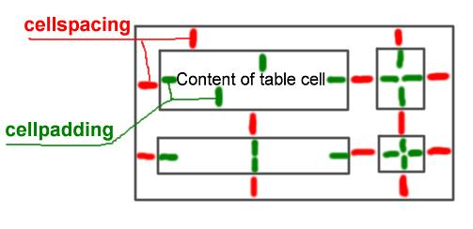
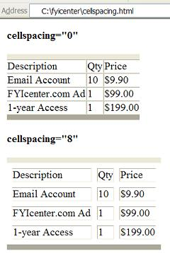
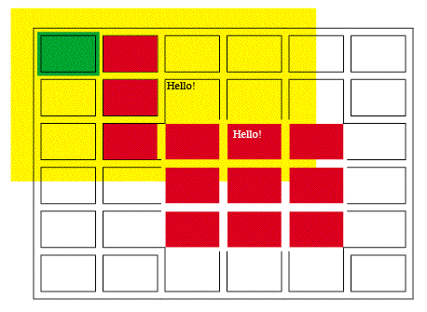
Table Cell Spacing and Cell Padding
Live Demo

Slide 21
Column and Row Span
Table cells have two important attributes:
colspan
Defines how many columns the cell occupies
rowspan
Defines how many rows the cell occupies
colspan="1"
colspan="1"
rowspan="2"
rowspan="1"
cell[1,1]
cell[1,2]
cell[1,1]
cell[1,2]
cell[2,1]
cell[2,1]
colspan="2"
rowspan="1"

Slide 22
Column and Row Span – Example
table-colspan-rowspan.html
<html>
<head><title>Colspan and Rowspan</title></head>
<body>
<br/>
<table cellspacing="0" cellpadding="10"
border="1">
<tr bgcolor="yellow"><td>Cell[1,1]</td>
<td colspan="2">Cell[2,1]</td></tr>
<tr bgcolor="#FFCC66"><td>Cell[1,2]</td>
<td rowspan="2">Cell[2,2]</td>
<td>Cell[3,2]</td></tr>
<tr bgcolor="#CCCCFF"><td>Cell[1,3]</td>
<td>Cell[2,3]</td></tr>
</table>
</body>
</html>

Slide 23
Column and Row Span – Example (2)
table-colspan-rowspan.html
<html>
<head><title>Colspan and Rowspan</title></head>
<body>
<br/>
<table cellspacing="0" cellpadding="10"
border="1">
<tr bgcolor="yellow"><td>Cell[1,1]</td>
<td colspan="2">Cell[2,1]</td></tr>
<tr bgcolor="#FFCC66"><td>Cell[1,2]</td>
<td rowspan="2">Cell[2,2]</td>
<td>Cell[3,2]</td></tr>
<tr bgcolor="#CCCCFF"><td>Cell[1,3]</td>
<td>Cell[2,3]</td></tr>
</table>
</body>
</html>
Cell[1,1]
Cell[2,1]
Cell[1,2]
Cell[2,2]
Cell[3,2]
Cell[1,3]
Cell[2,3]

Slide 24
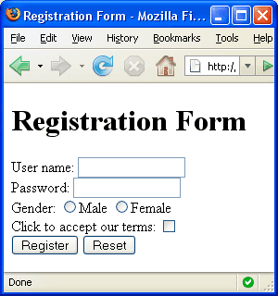


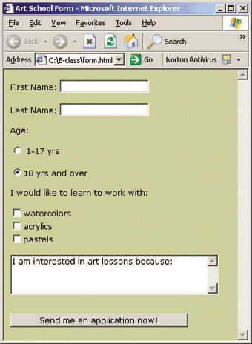
HTML Forms
Entering User Data from a Web Page

Slide 25
HTML Forms
Forms are the primary method for gathering data from site visitors
Create a form block with
Example:
The “method" attribute tells how the form data should be sent – via GET or POST request
<form></form>
<form name="myForm" method="post" action="path/to/some-script.php">
...
</form>
The "action" attribute tells where the form data should be sent

Slide 26
Form Fields
Text fields are single-line entry fields:
Text areas can contain multiple lines of text:
Hidden fields contain data not shown to user:
Often used by JavaScript code
<input type="text" name="FirstName" value="This is a text field">
<textarea name="Comments">This is a multi-line text field</textarea>
<input type="hidden" name="Account" value="This is a hidden text field">

Slide 27
Form Input Controls
Create a checkbox:
Create a radio button:
Radio buttons can be grouped, allowing only one to be selected from a group:
<input type="checkbox" name="fruit" value="apple">
<input type="radio" name="title" value="Mr.">
<input type="radio" name="town" value="Sofia">
<input type="radio" name="town" value="Varna">

Slide 28
Other Form Controls
Pull down menu (drop-down list):
Submit button:
<select name="gender">
<option value="Value 1"
selected="selected">Male</option>
<option value="Value 2">Female</option>
<option value="Value 3">Other</option>
</select>
<input type="submit" name="submitBtn" value="Apply Now">

Slide 29
Other Form Controls (2)
Reset button – clears the form
Image button – acts like submit but image is displayed instead of button
Ordinary button – used for JavaScript, no default action
<input type="reset" name="resetBtn" value="Clear the form">
<input type="image" src="submit.gif" name="submitBtn" alt="Submit">
<input type="button" value="simple button">

Slide 30
Other Form Controls (3)
Password input – acts like normal text field but hides the text with * signs
Multiple select field – code is like drop down but displays list of items to select
<input type="password" name="pass" value="">
<select name="products" multiple="multiple">
<option value="Value 1"
selected="selected">keyboard</option>
<option value="Value 2">mouse</option>
<option value="Value 3">speakers</option>
</select>

Slide 31
HTML Forms – Example
form.html
<form method="POST" action="apply-now.php">
<input name="subject" type="hidden" value="Class" />
<p>Degree:
<select name="degree">
<option value="BA">Bachelor of Art</option>
<option value="BS">Bachelor of Science</option>
<option value="MBA" selected="true">Master of
Business Administration</option>
</select>
</p>
<p>
First Name: <input type="text" name="firstname" />
</p>
<p>
Last Name: <input type="text" name="lastname" />
</p>
<p>
Student ID: <input type="password" name="studentid" />
</p>

Slide 32
HTML Forms – Example (2)
form.html (continuation)
<p>
Gender:
<input name="gender" type="radio" value="Male"
checked="true" /> Male
<input name="gender" type="radio" value="Female" />
Female
</p>
<p>
E-mail: <input type="text" name="email" value="" />
</p>
<p>
<textarea name="terms" cols="30" rows="4"
readonly="true">TERMS AND CONDITIONS
By clicking the Send Form button you agree to submit this form.</textarea>
</p>
<p>
<input type="submit" name="button" value="Send Form" />
</p>
</form>

Slide 33
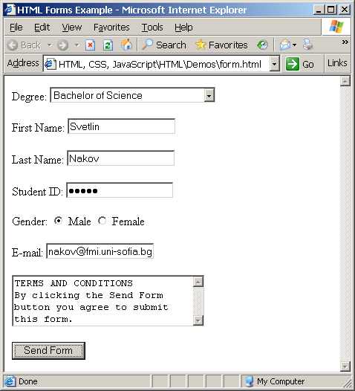
HTML Forms – Example (3)
form.html (continuation)
<p>
Gender:
<input name="gender" type="radio" value="Male"
checked="true" /> Male
<input name="gender" type="radio" value="Female" />
Female
</p>
<p>
E-mail: <input type="text" name="email" value="" />
</p>
<p>
<textarea name="terms" cols="30" rows="4"
readonly="true">TERMS AND CONDITIONS
By clicking the Send Form button you agree to submit this form.</textarea>
</p>
<p>
<input type="submit" name="button" value="Send Form" />
</p>
</form>

Slide 34
HTML – Tables and Forms
?
?
?
?
?
Questions?
?
?
?
?
?
http://academy.telerik.com

